Slide 1
Alaskan Salmon
Evan Adams

Slide 2
Hypothesis
There is a significant correlation between the climate change occurring and the quality of salmon caught in Alaska

Slide 3
Why is this important?
Largest harvest in North America:
Alaska's salmon harvest is the largest in North America, accounting for about 80% of the total wild-caught catch.
Employment:
More Alaskans work in salmon harvesting and processing than in any other commercial fishery.
Economics:
Salmon accounts for the majority of the value of Alaska seafood.

Slide 4
Industry Challenges

Slide 5
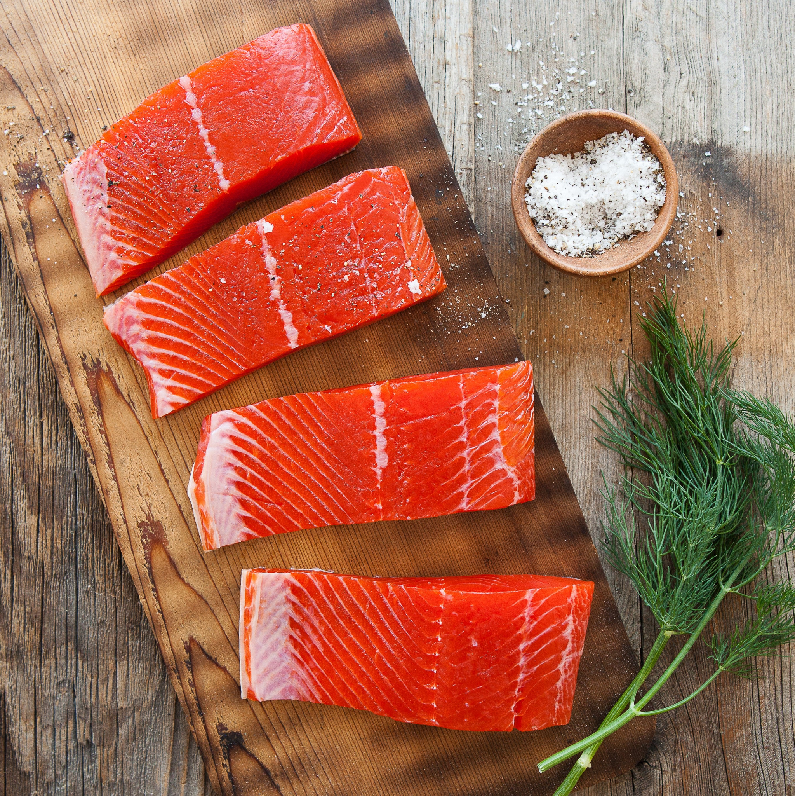
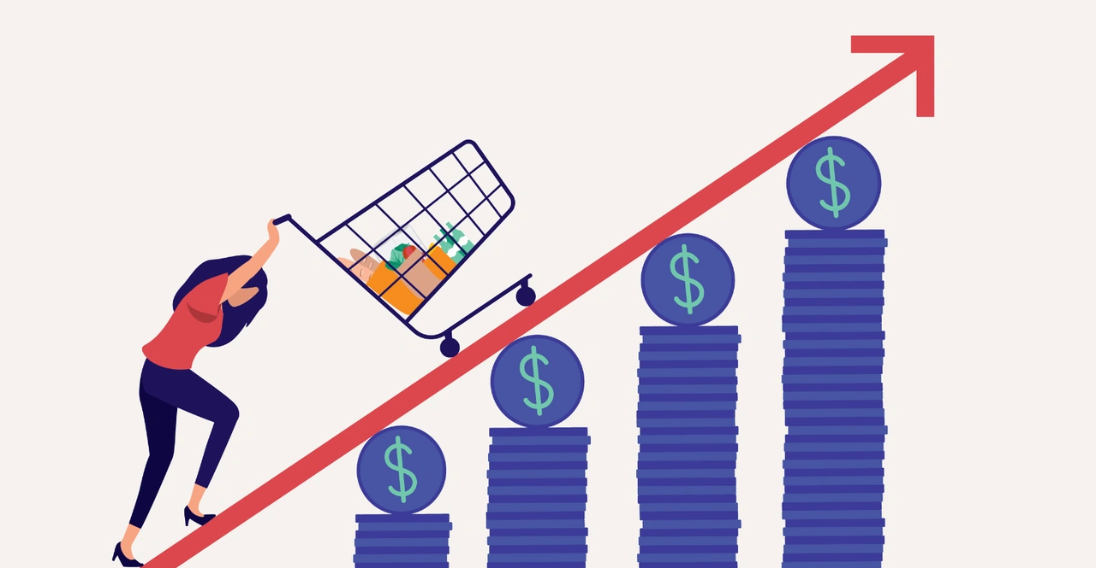
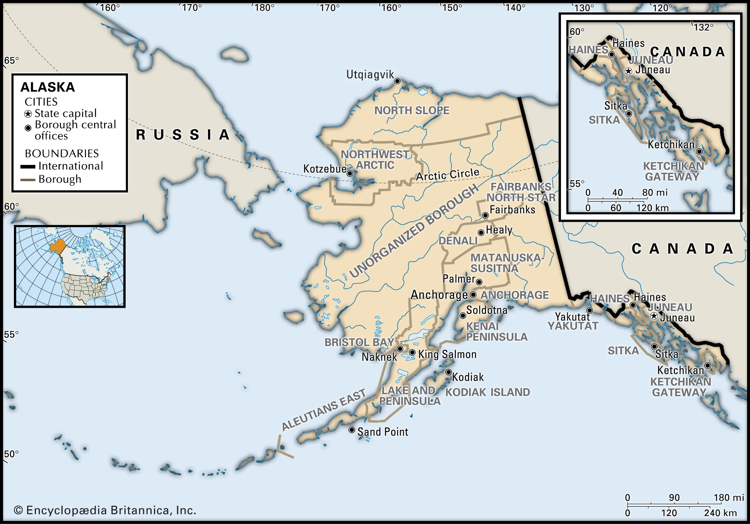
Inflation
High inflation and interest rates have squeezed profit margins
Labor costs
Wages continue to rise
Fuel concerns
Diesel fuel prices continue to rise
Geographical competition
Alaskan fisherman compete against against foreign imports

Slide 6
Data

Slide 7
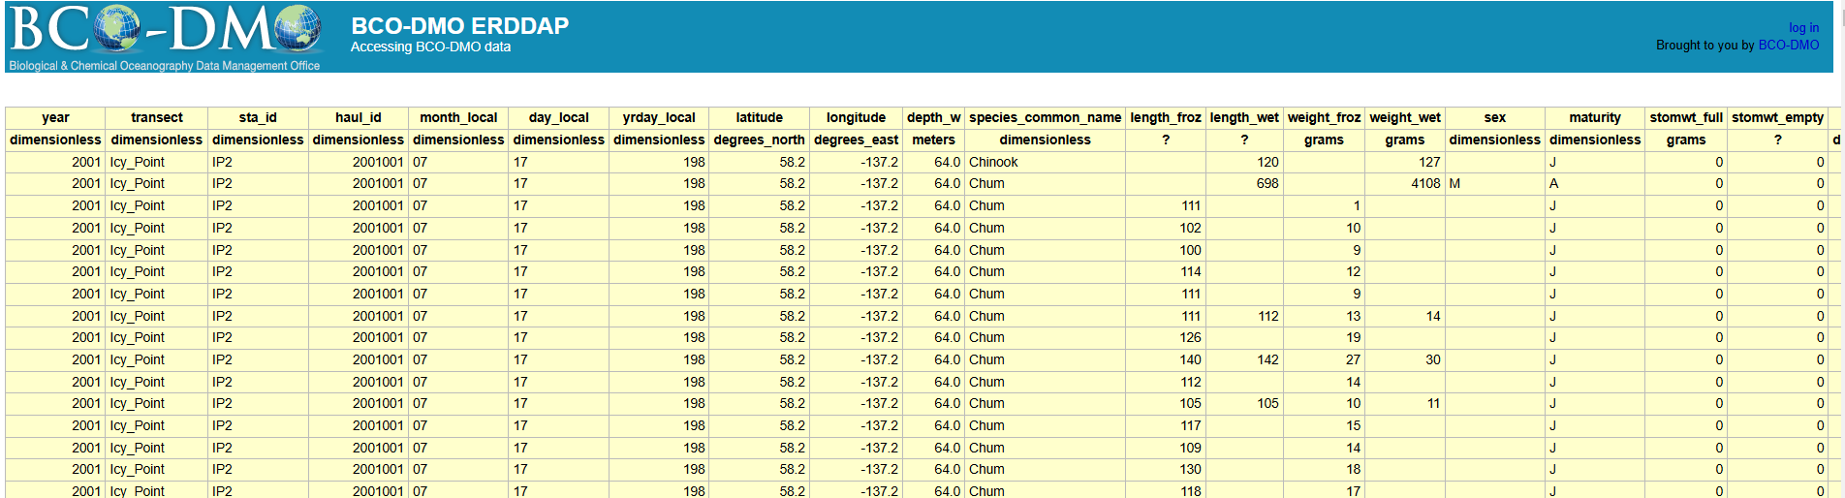
Salmon Datasets
Variables
Year (month, day)
Longitude, Latitude
Transect (company selling salmon)
Measurements (frozen & wet)
Length(cms) & Weight(grams)
Sex & Maturity
Biological & Chemical Oceanography Data Management Office
https://www.bco-dmo.org/dataset/3106
Queried the Salmon biodata
https://erddap.bco-dmo.org/erddap/tabledap/bcodmo_dataset_3106.htmlTable

Slide 8
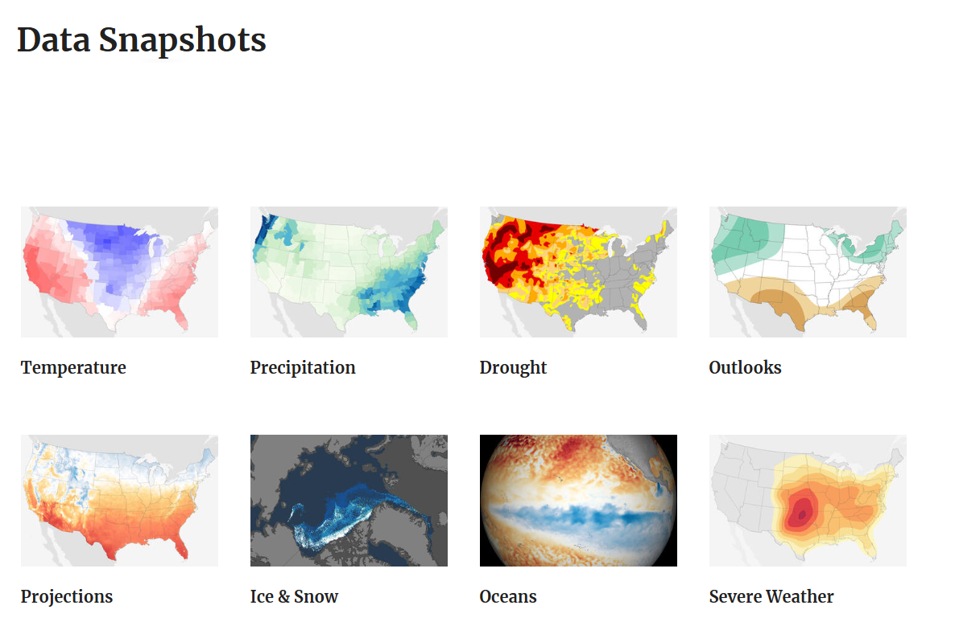
Climate Datasets
Past Weather by Zip Code
https://www.climate.gov/maps-data/dataset/past-weather-zip-code-data-table
NASA - ClimateData Services
https://www.nccs.nasa.gov/services/climate-data-services

Slide 9
Statistical Analysis
Data Acquisition
Collect Salmon Biodata
Integrate Environmental Data
Correlation & Hypothesis Testing
Analyze relationships between environmental factors and Salmon characteristics through the years
Predictive Modeling/Trend Analysis
Example: linear regression to model the impact of environment variables on salmon size and eventually quality

Slide 10
Future Developments
Economic Impact
Forecast grocery pricing
One of the top industries for Alaska
Climate Change Studies
Expand data
Ocean pH & oxygen levels
Geographical Impact
How does fishing here affect the ecosystem?
Good or Bad?

Slide 11
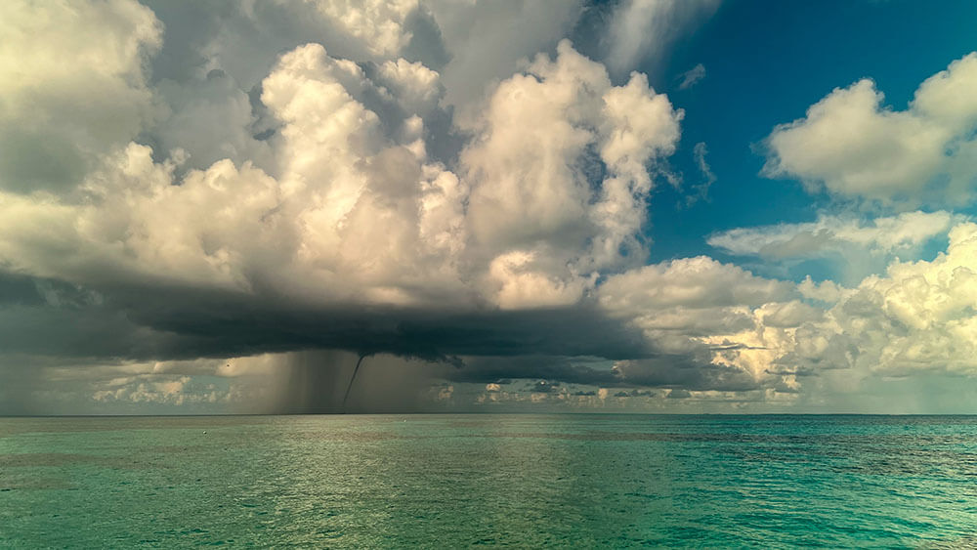
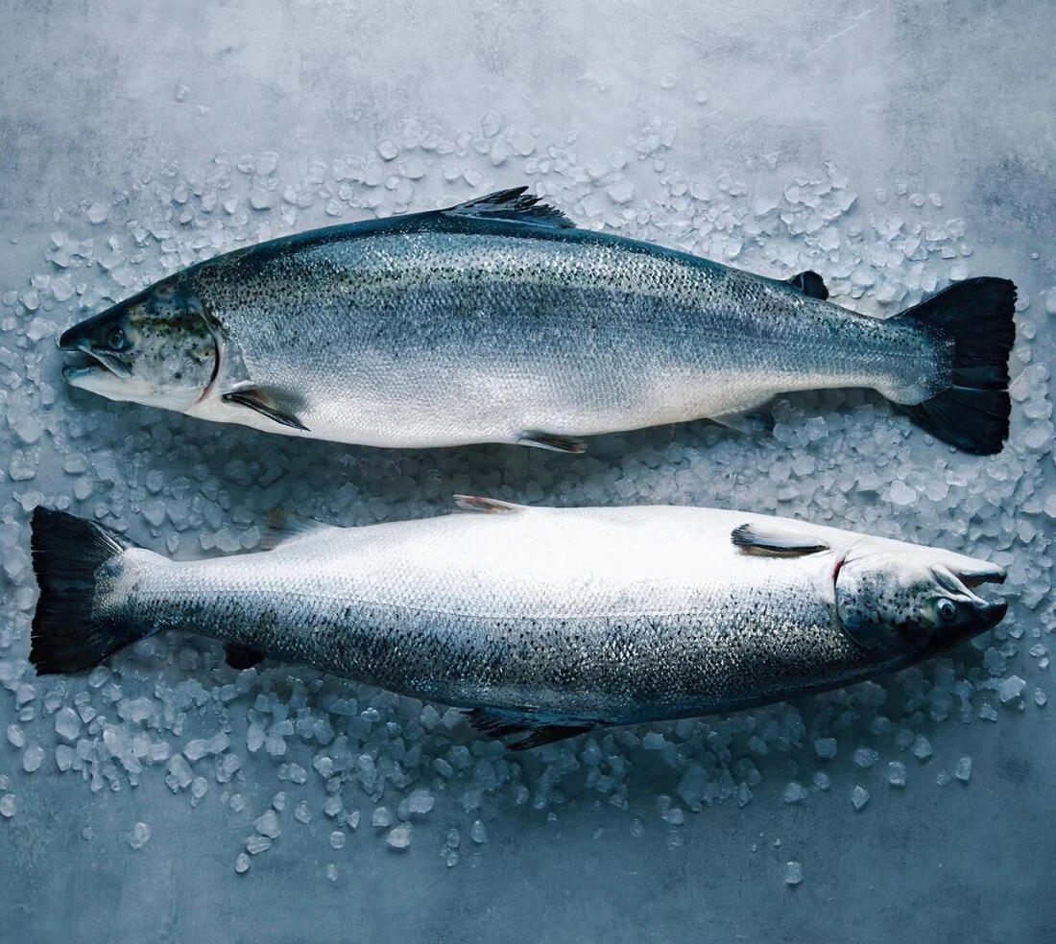
Key Takeaways
Statistical analysis reveals potential correlations between climate change factors
Temperature, sea level, and salmon quantity/quality.
Python to visualize all of this data for a dashboard
Any industry that is impacted by this study can easily read through and extract how this impacts them and their field
Analysis and expand to other farming practices.
Other Countries/States, Businesses, Forecasting costs and profits

